Slide 1
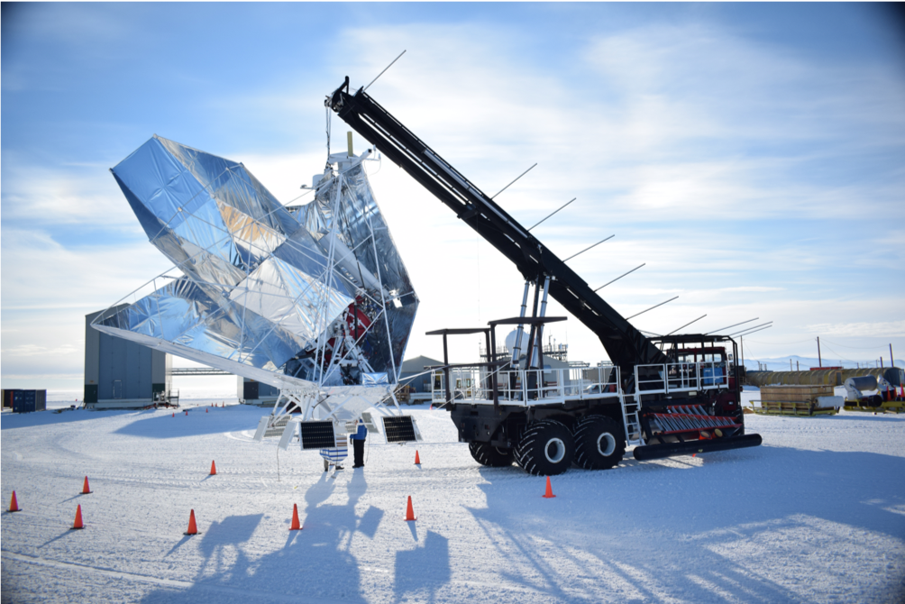

BLAST-TNG to G3
Packaging BLAST-TNG data into G3 files for CCAT Quick-Look Map-Maker development
Jonah Lee
.g3

Slide 2
[Links]
https://github.com/jonahjlee/blasttng-to-g3/tree/main
G3 File Processing - Google Slides
https://cmb-s4.github.io/spt3g_software/index.html
https://github.com/ccatobs/rfsoc-streamer
https://so3g.readthedocs.io/en/latest/
https://github.com/arahlin/spt3g_tutorials/blob/main/filter_and_bin_mapmaking.ipynb

Slide 3
Motivation
Detector data for CCAT will be available to the Quick-Look Mapmaker in the form of .g3 files
Packaging BLAST-TNG data into .g3 files provides ideal sample data:
James & Jonah are very familiar with this data
We already know how to make maps with BLAST-TNG data (main repo / Jonah’s fork)
The data shares some similarity with CCAT:
MKID data on several RF networks
Relatively large number of detectors (though still much lower than CCAT!)
BLAST-TNG data is already available & ready to go on the CCAT Control Computer
Once packaged, the BLAST-TNG .g3 can be used for development and testing of a new quick-look mapmaker
We can begin porting our mapmaking code to the .g3 format
We can experiment with pipelines and various ways to improve performance
We can also create synthetic .g3 files with more data to determine performance characteristics of the mapmaker (i.e., how does time/space scale with number of detectors or downsampling rate?)

Slide 4
Goals
We want this sample .g3 data to be as close as possible to the format we will get for CCAT
The closer it is, the lower the cost will be once we transition from BLAST-TNG .g3 data to real CCAT data.
Communicating with DAQ team will help establish parity between the formats
It would be helpful to have several different forms/versions of .g3 sample data
Various data rates/file sizes due to different number of detectors
Could duplicate detectors to create more data, or just add garbage data for performance testing purposes
duplicating data may lead to inaccurate performance results if some optimizations cause unnatural speedups
Provide adequate documentation (slides, READMEs, code comments, docstrings…) such that somebody in the future can:
Create new .g3 files with different data
Understand the format of the existing BLAST-TNG .g3 files and work with them

Slide 5
Target Timeline (as of March 31st, 2025)
March 31st - April 4th
Decide on format for .g3 files -- what kind of frames, what data will be stored, etc.
Construct preliminary .g3 files from BLAST-TNG data on control computer
April 7th - 11th
Begin porting https://github.com/jonahjlee/map_making_blasttng_jl to build maps from .g3 files, using G3 pipelines
Continue to update .g3 files to improve CCAT parity & provide different variants for testing
April 14th - 18th
Characterize memory/speed of the map-maker as a function of number of detectors & data rate (we can control down-sampling)
Continue porting map-maker code to .g3
April 21st - 25th (Jonah’s last week!)
Continue with performance characterization & map-making code
Wrap-up documentation and slides to make sure future developers can understand and manipulate the .g3 data

Slide 6
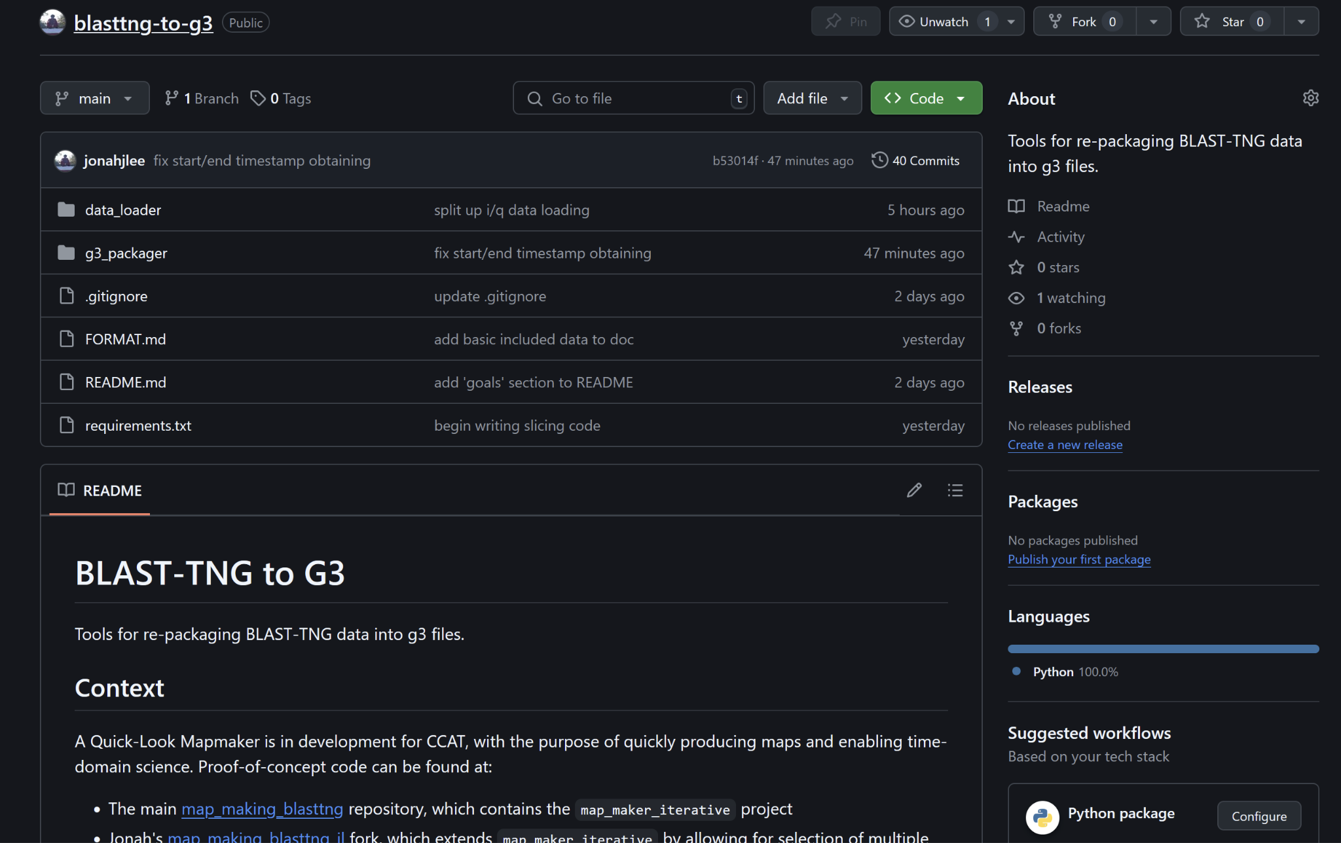
GitHub Repository
GitHub - blasttng-to-g3
data_loader re-uses a lot of code from map_making_blasttng_jl
Must run on control computer to access BLAST data

Slide 7
Minimum Required Data for Map-Making
Time
Site Location
Boresight Az/El
Detector Offsets
Detector I / Q raw timestreams
Calibration Lamp Timestamps?
Since calibration for BLAST-TNG will not be done in the same way as CCAT, it may make more sense to pre-compute and store calibration lamp DF (delta-frequency) per-detector in a Calibration Frame
Edit April 4: It turns out I needed to add the calibration sweep data so that DF could be calculated.

Slide 8
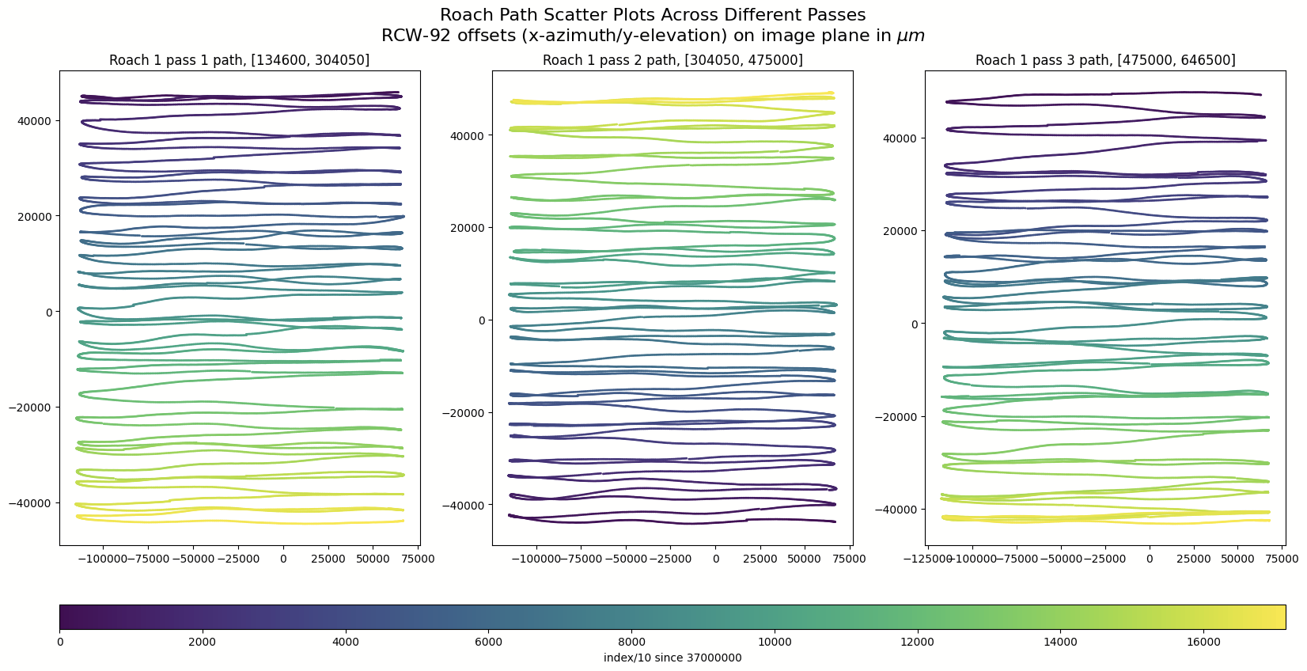
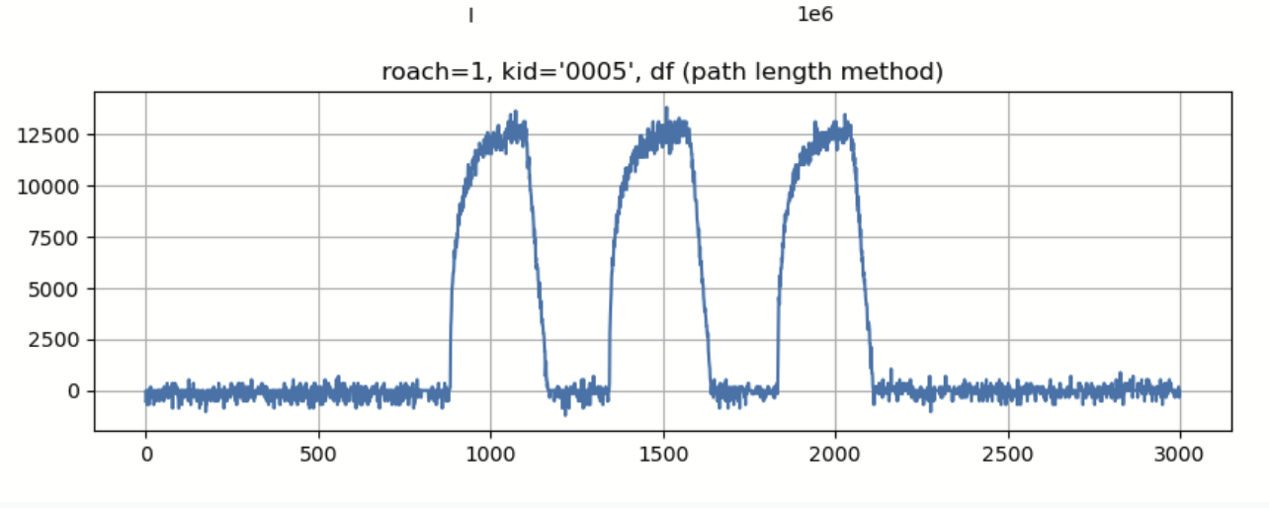
Division of BLAST-TNG Data in Time
RCW-92 scan 1
RCW-92 scan 2
RCW-92 scan 3
calibration lamp
(3 pulses)
other data
other data
t=0
t=356s
t=714s
t=1064s
t=1070s

Slide 9
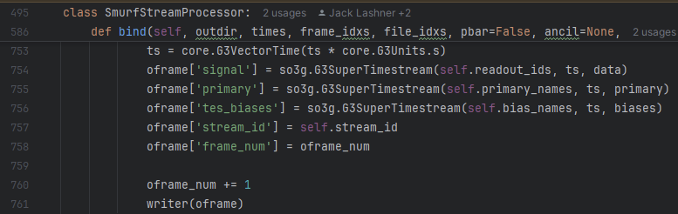
Reference Code: sotodlib
The Simons’ sotodlib repository contains lots of code that can be referenced as examples of how to use spt3g and so3g packages.
The bookbinder code linked below contains lots of code that I can learn from:
https://github.com/simonsobs/sotodlib/blob/master/sotodlib/io/bookbinder.py

Slide 10
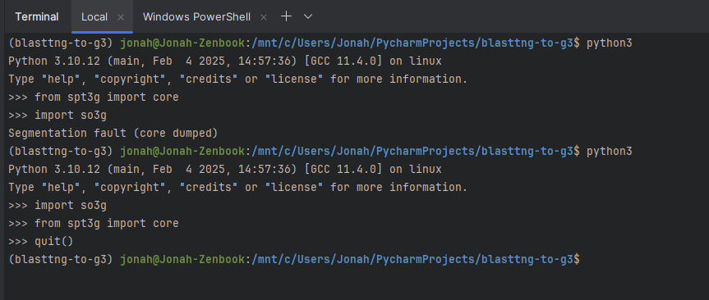
Strange Import Bug
I was able to replicate the behaviour shown below in multiple environments.
For some reason, import so3g will cause a segmentation fault if if is preceded by from spt3g import core. Switching the order resolves the issue.

Slide 11
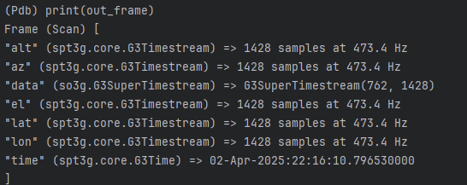
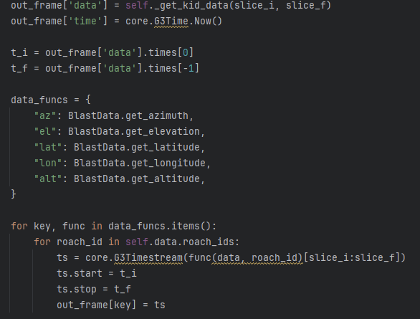
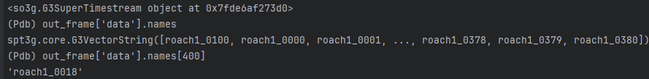
First Frames Made!
Objects have been added!
Frequency seems a bit off?
See next slide
762 detectors
381 present in Roach 1; I/Q for both
currently, the program runs out of memory if run with all 4 Roaches
I forgot to append i/q to the names, so there are duplicate names in the G3SuperTimestream

Slide 12
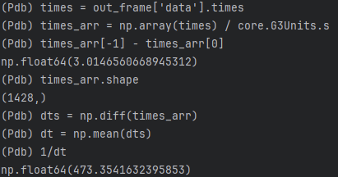
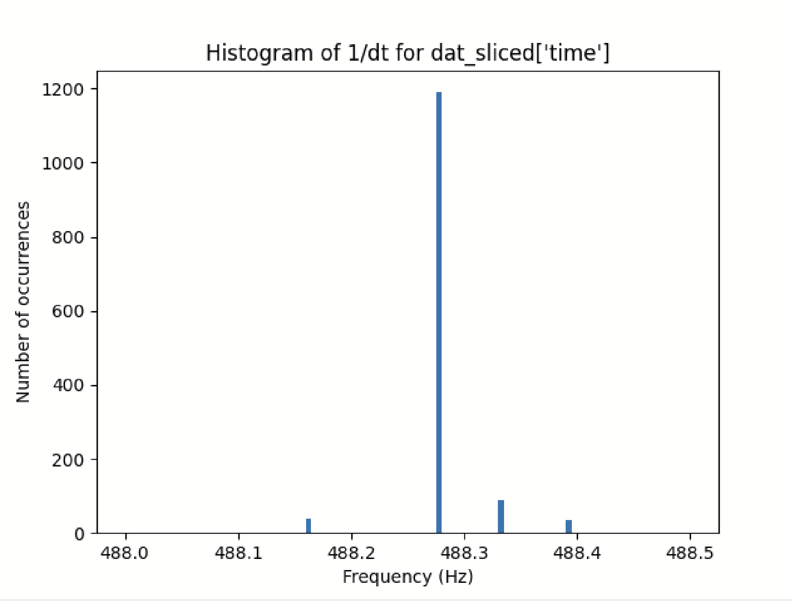
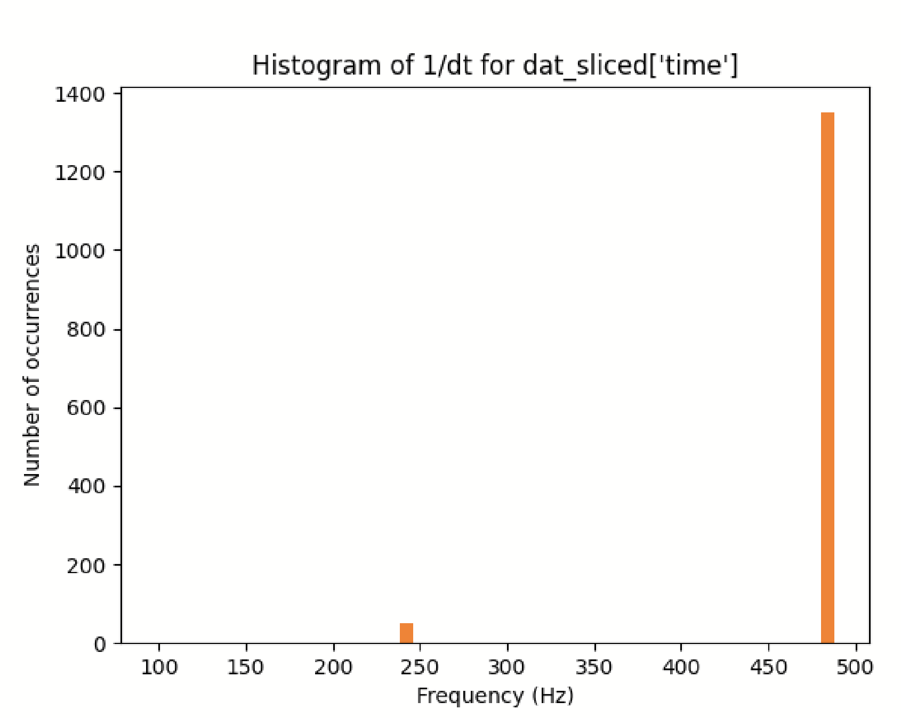
Frequency Discrepancies
James: “... we expect sampling frequency for BLAST-TNG data (and as of right now also CCAT) to be 512e6/1024^2=488.28125 Hz. 512e6 is the clock frequency, and 1024 channels, 1024 accumulations”
https://github.com/jonahjlee/map_making_blasttng_jl/blob/main/time_slicing.ipynb
In this notebook, I found the average frequency to be 476.5 Hz
I used roach_1’s dat_sliced[‘time’] as the ground truth
The difference between the vals at 0 and 1427 is 3.014656
This corresponds to the frequency of 473.4
The actual values are mostly 1/dt=488 Hz, but there are some values at 244 Hz, and other variations around 488Hz. The result is a mean frequency of 473.4Hz
All frequencies:
Zoomed
to 488Hz:

Slide 13
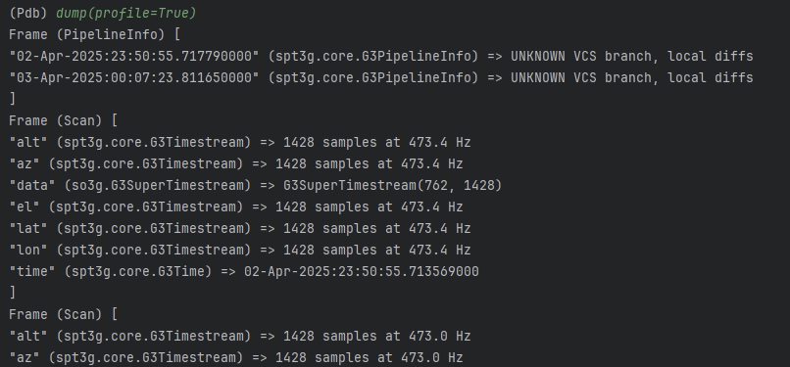
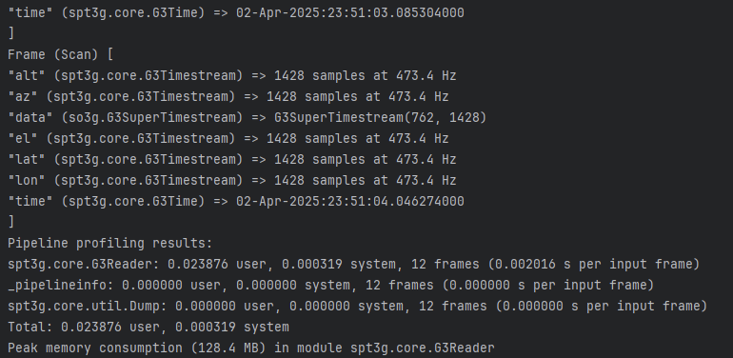
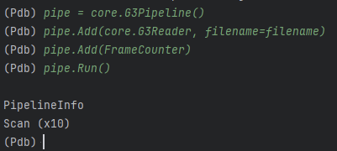
Successfully Loading .g3 File
Test file: contained 10 frames
Pipeline reads data as expected
PipelineInfo is added automatically as expected
… (10 total scan frames)

Slide 14
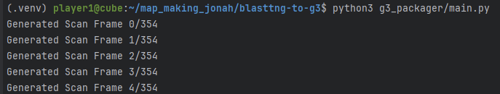
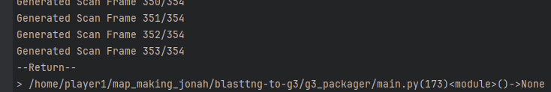
Roach 1 - All 3 Passes .g3 File
354 frames * 3s = 17min 42s
testfile.g3 file: 876MB
Off by one error? There should have been a Scan Frame with frame_num=354

Slide 15
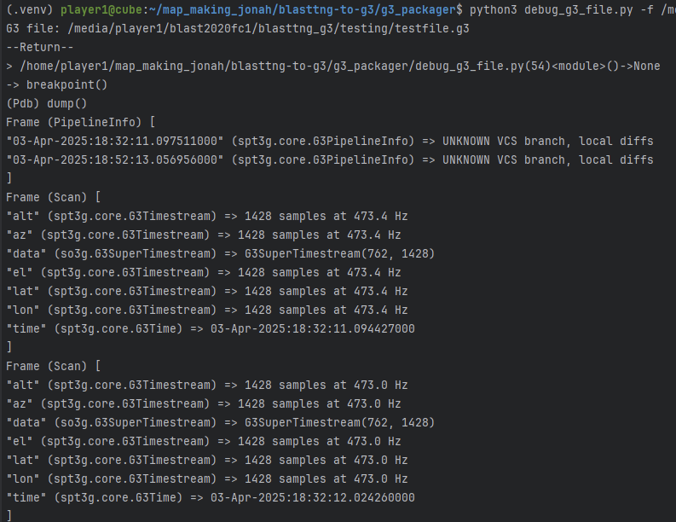
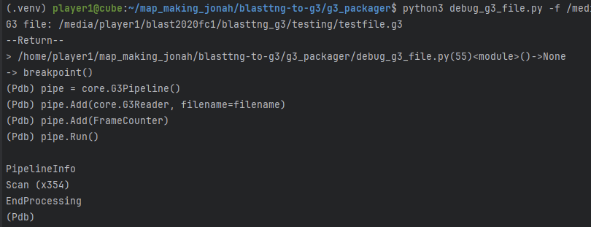
Roach 1 - All 3 Passes .g3 File
Contents look OK except we should have gotten 1 more scan frame with fewer samples at the end

Slide 16
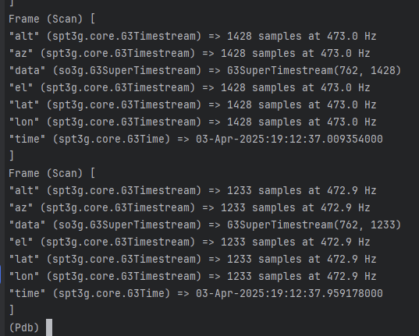
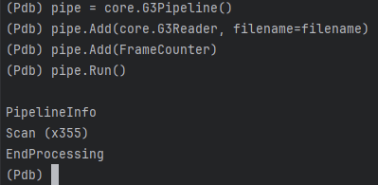
Bug Fixed - Last Frame Missing
We now have 355 Scan frames instead of 354
The last frame indeed has fewer samples, reflecting the fact that we have run out of data
Pipeline profiling results: __main__.ScanFrameGenerator: 227.104404 user, 70.923824 system, 356 frames (0.837158 s per input frame) _pipelineinfo: 0.000189 user, 0.000258 system, 356 frames (0.000001 s per input frame) spt3g.core.G3Writer: 45.993677 user, 0.556452 system, 357 frames (0.130393 s per input frame) Total: 273.098270 user, 71.480534 system Peak memory consumption (2902.8 MB) in module __main__.ScanFrameGenerator

Slide 17
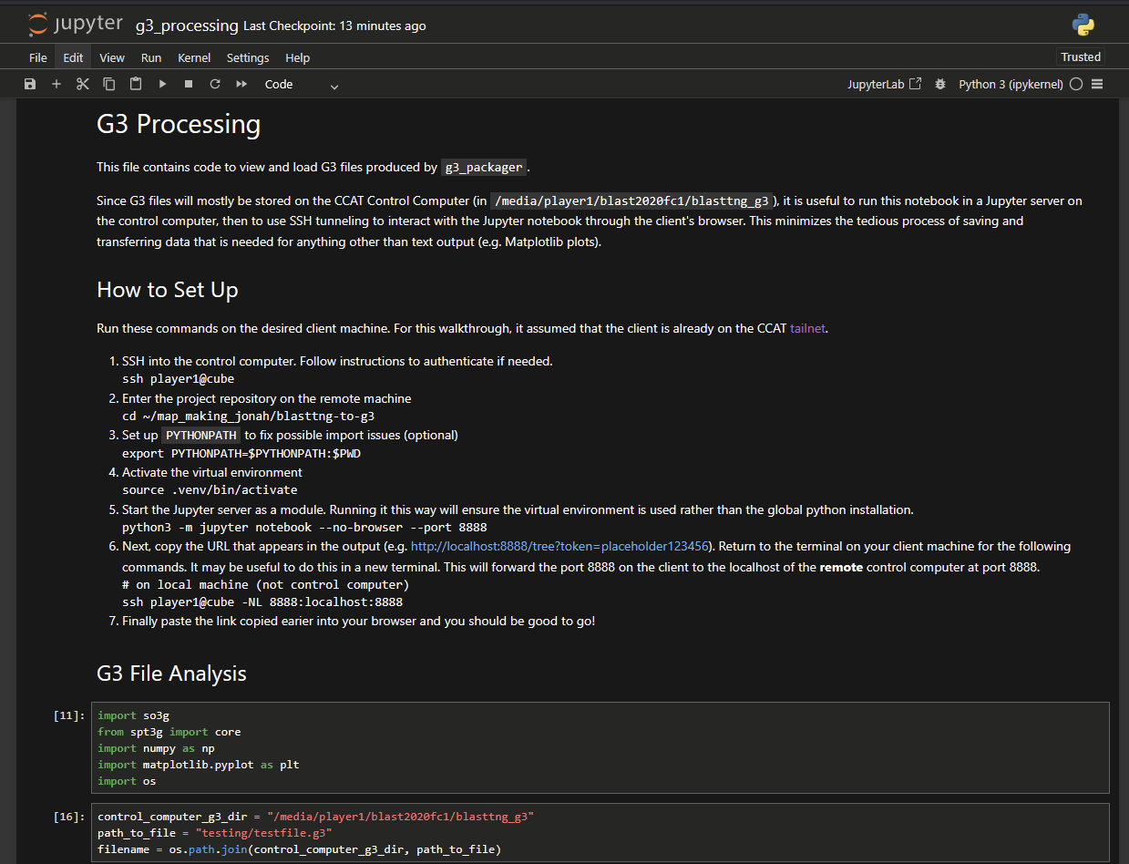
Remote Jupyter Notebook Development
https://github.com/jonahjlee/blasttng-to-g3/blob/main/g3_processing.ipynb
Provides a native Jupyter environment while working on an ssh connection to control computer
Access the files stored under /media/player1/blast2020fc1/blasttng_g3

Slide 18
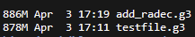
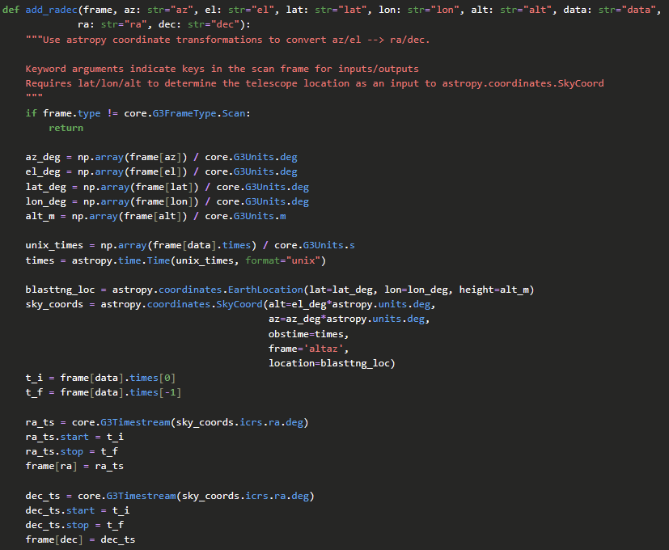
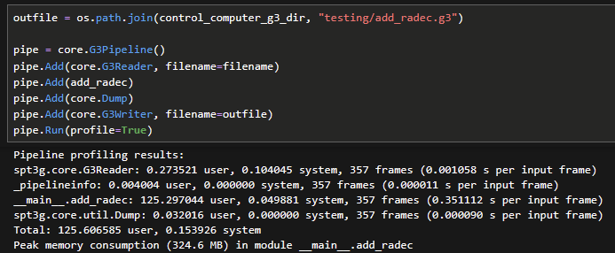
Pipeline: Compute RA/DEC
Load file, compute, add data & save
add_radec dominates runtime: 0.35s processing for each 1428-long frame
325MB peak memory use

Slide 19
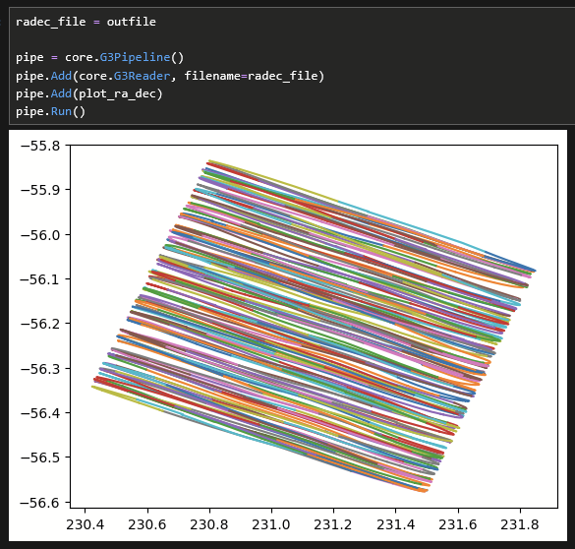
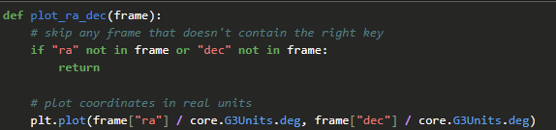
RA/DEC Looks Good!
The plot shown is for all 3 passes in elevation
Plotting takes only a few seconds

Slide 20
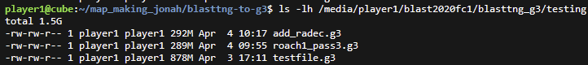
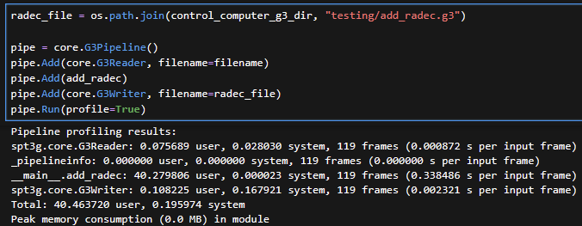
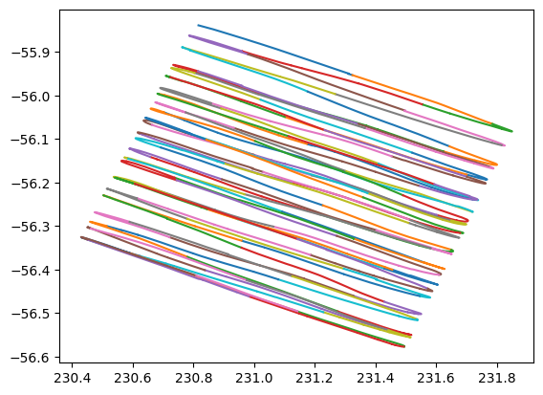
Smaller File: roach1_pass3.g3
Shortened from 355 Scans → 117 Scans
Time used by add_radec is linear with number of frames (unsurprisingly)
Approximately the same time for each input frame
Note: I am encountering a bug with the profile=True options where it doesn’t print the output
RA/DEC plot for scans in pass 3

Slide 21
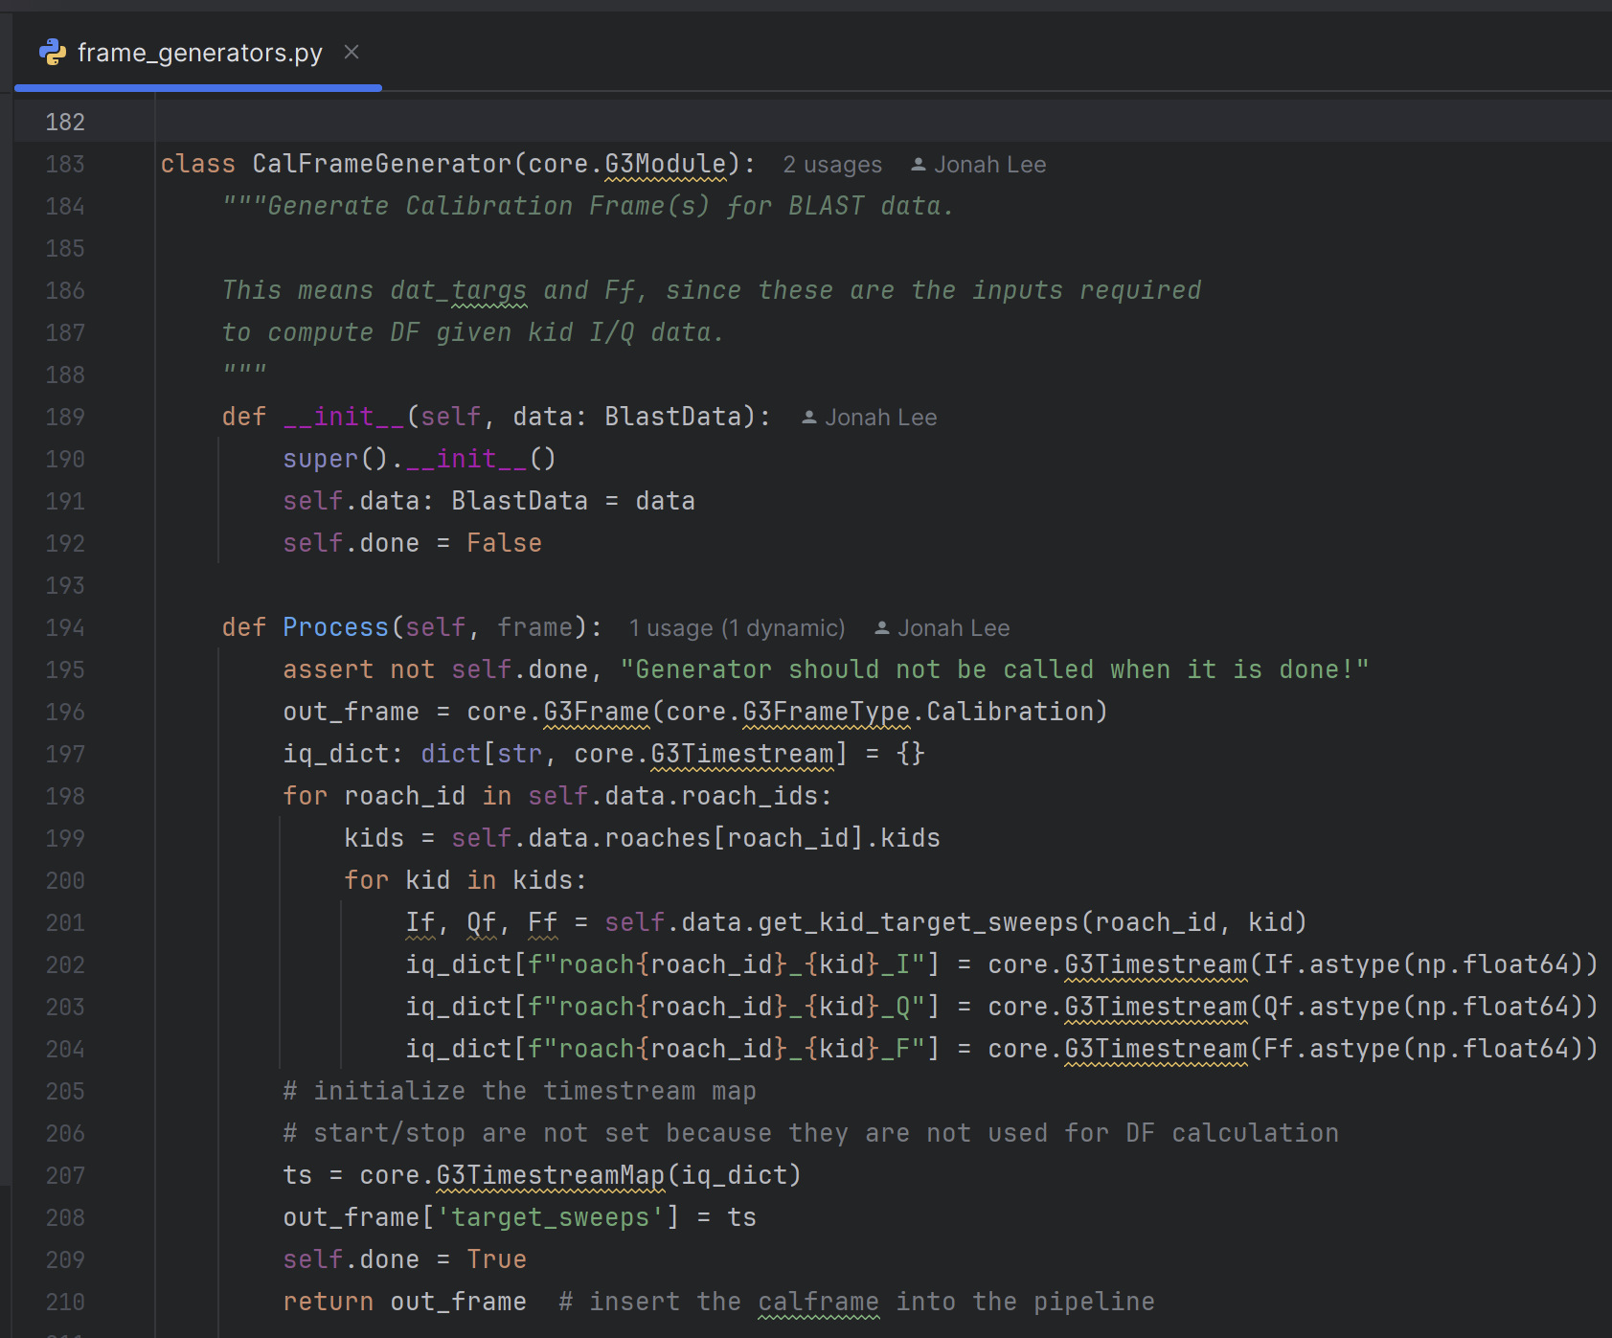
Add Calibration Data
In order to compute DF, we first need to add target sweep data for each KID
Opted for a G3TimestreamMap which contains keys like “roach1_0100_I”, “roach1_0100_Q” or “roach1_0100_F”, where I/Q/F indicates I/Q signal, or F for frequency data
I also took the opportunity to refactor g3_packager/main.py and organise frame generation modules

Slide 22
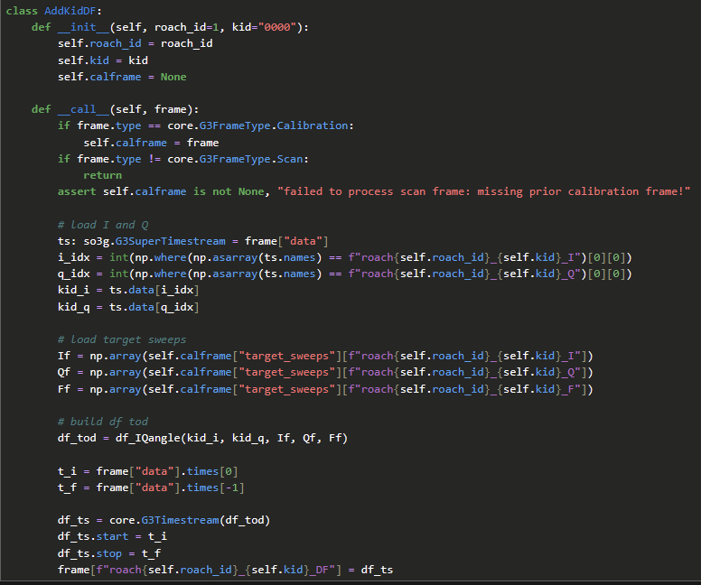
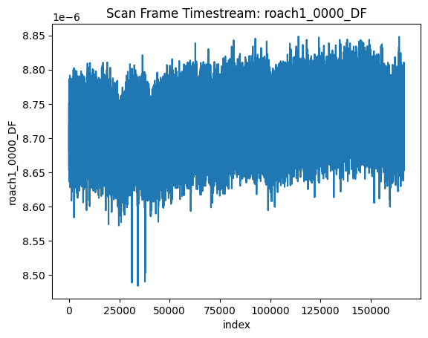
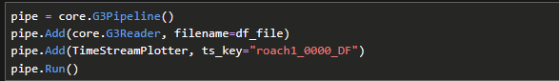
New Module: Compute DF
→ Use newly added calibration frame data Plot: Roach 1 Kid 0 Pass 3 DF (non-normalized)

Slide 23
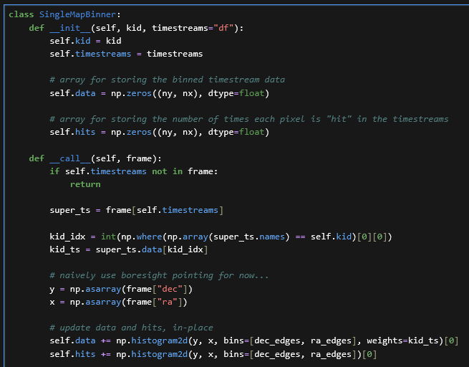
Single KID Maps
module source: https://github.com/arahlin/spt3g_tutorials/blob/main/filter_and_bin_mapmaking.ipynb

Slide 24
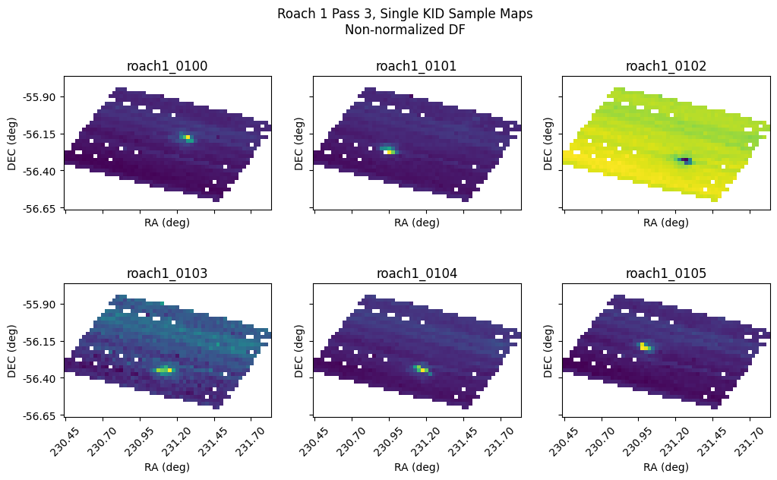
BAD DF CALCULATION

Slide 25
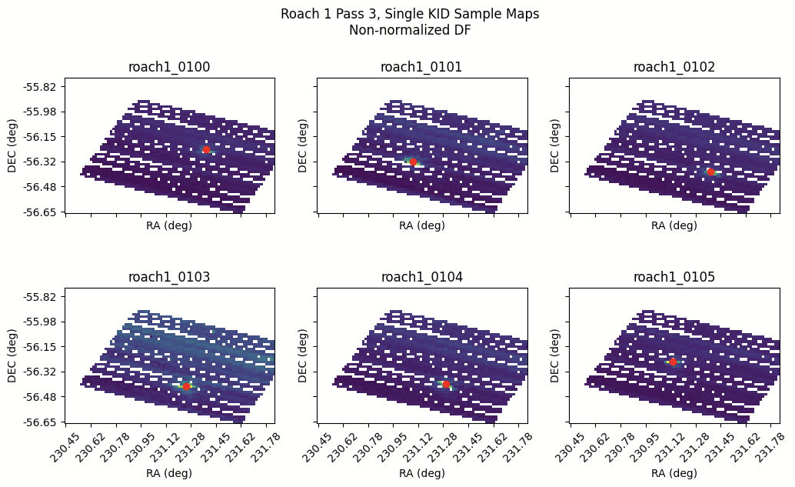
FIXED + SOURCE FINDING

Slide 26
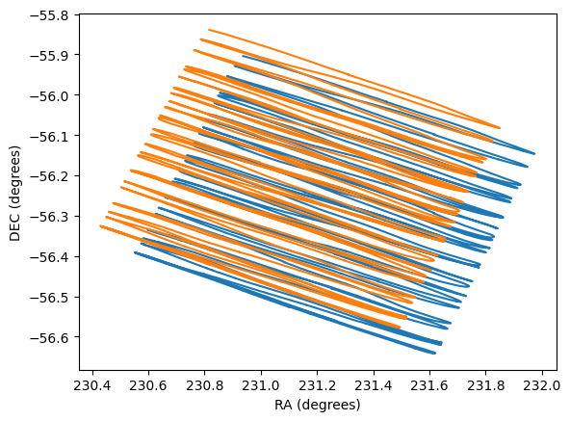
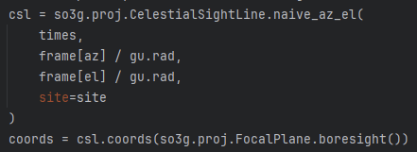
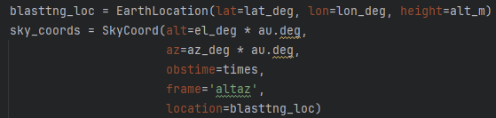
Different RA/DEC computations
so3g.proj (blue)
Astropy SkyCoord (orange)
so3g uses avg. location over 3s scan, also runs much faster.
Are differences due to atmospheric effects? (see naive_az_el doc)

Slide 27
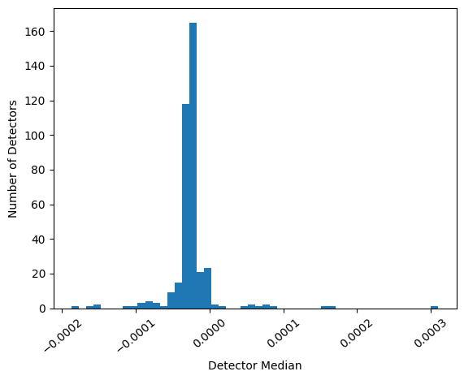
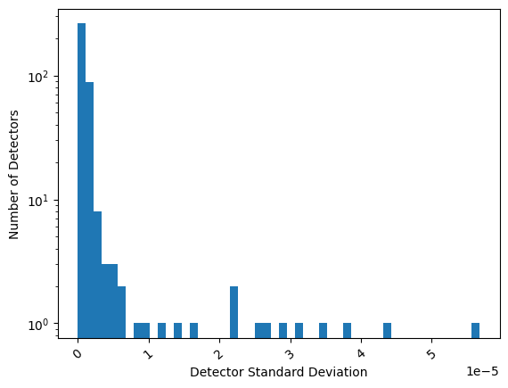
Stats for Non-Normalized DF, Roach 1 Pass 3

Slide 28
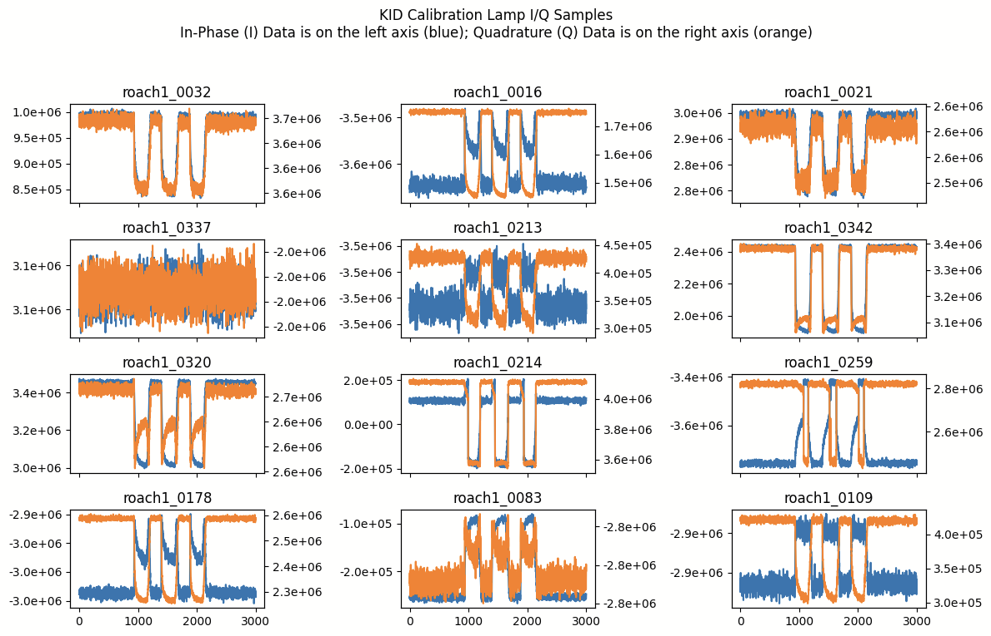

Slide 29
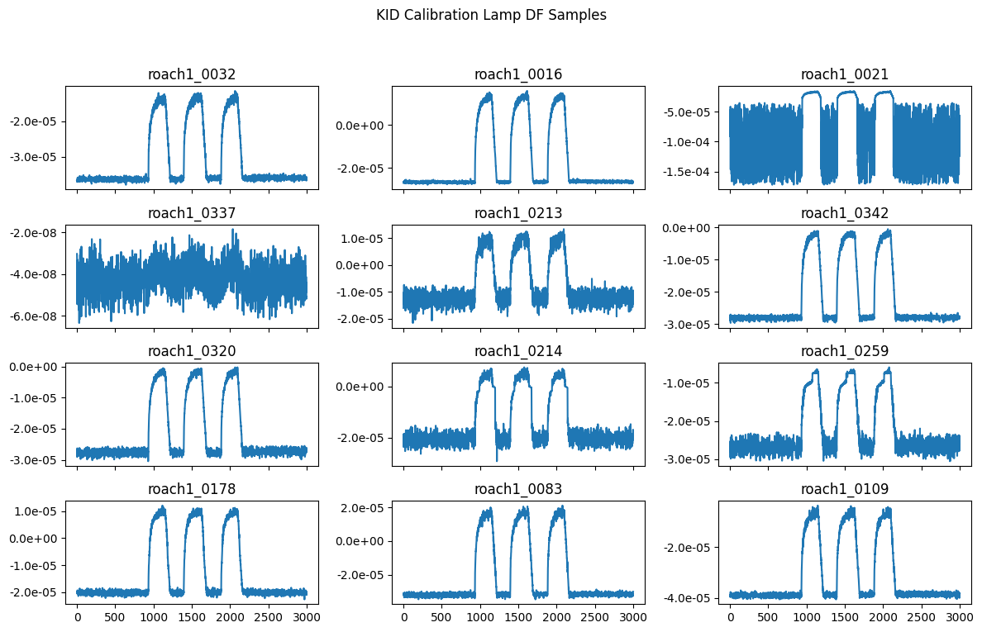

Slide 30
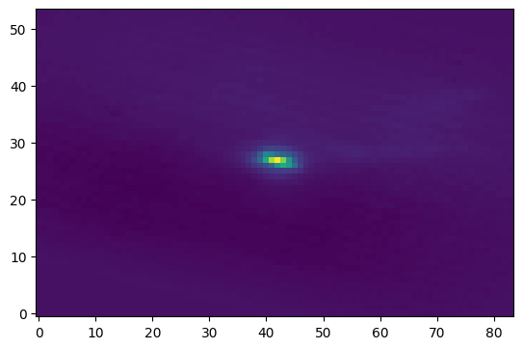
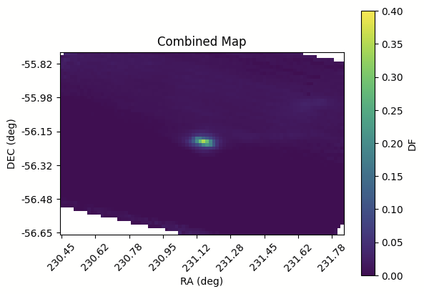
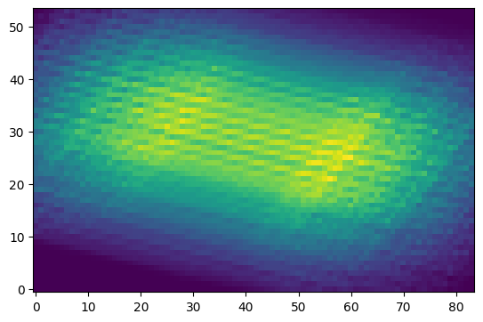
Combined Map
“data”: sum of binned signals
Roach 1 Pass 3, normalized DF bad KIDs excluded, no common-mode removal KIDs weighted by 1/variance
Map is given by “data”/“hits”
“hits”: number of data
points in each bin

Slide 31
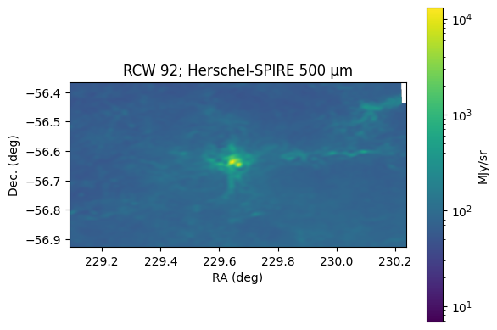
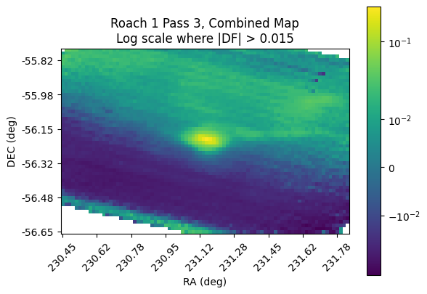
Log Scale
Note: coordinates for the plot on the left are offset from the real value.

Slide 32
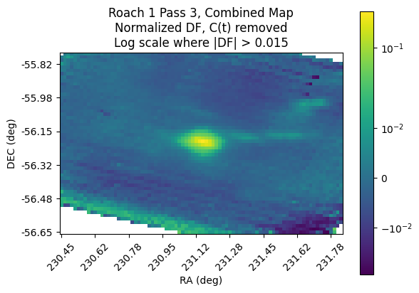
Log Scale + Common Mode Removed
Note: coordinates for the plot on the left are offset from the real value.

Slide 33

10x Resolution (6 arcsec)
Reducing the bin size effectively narrows the size of the lines that detectors trace on the sky.
By observing the striping shown when increasing the resolution, we can see how different detectors have different magnitudes despite DF normalization.
This is likely due to non-linearity in the DF response (as it is computed right now), where calibrating to one brightness does not necessarily calibrate for all brightnesses.

Slide 34

10x Resolution - “hits”
Elevation
Because we aligned detectors to the source, it appears as though every detector passed directly through the source, though this is not actually true.
As a result we get bands in azimuth because the delta-elevation is relatively constant so the scans line up.
We also can see lines in elevation, which correspond to the turnarounds for the scans for each detector.
Azimuth

Slide 35
SPT3G Maps Package
https://cmb-s4.github.io/spt3g_software/moddoc_maps.html
Contains map-making objects, pipelines modules and functions.
Lots of tools for projecting, binning timestreams, coordinate transformations, map masking & operations
Generally tailored for SPT3G’s purposes - bolometers, full-sky maps, polarization maps
Still broad and flexible enough to be useful for CCAT
Some examples:
FlatSkyMap, MapBinner, SingleDetectorBoresightBinner, MapMockObserver

Slide 36
How to store detector positions?
With any one of these, we can convert to the others pretty easily, so we ask only what to store natively in the file
BolometerPropertiesMap
https://cmb-s4.github.io/spt3g_software/moddoc_calibration.html
Native to spt3g software
Tailored more for SPT usage than for CCAT - has several useless properties
FocalPlane
https://so3g.readthedocs.io/en/latest/proj.html#so3g.proj.FocalPlane
Native to so3g.proj
More generic, contains rotation quaternion offsets and sensitivities
Makes sense if we want to use more of the fast so3g.proj code
Not a Frame Object, so we must either store it in memory or encode it manually
Custom / Generic
list/dict of x/y offsets?
could be simple, but does not provide a strong contract

Slide 37


Observation Frames
https://cmb-s4.github.io/spt3g_software/frames.html#id8
“Indicates global observation parameters. Changes at the beginning of a new observation, though, as with all metadata, repeat observation frames may appear during processing.”

Slide 38



Common-Mode Iteration
The first common-mode removal gets rid of the elevation gradient, and the subsequent iterations restore source brightness that was removed in the first c(t) removal.

Slide 39
Rework Source Determined Shifts
Source shifts were messy
confusing mixing of pixel/image plane microns/radec/azel coordinates
The computed RA/Dec from master az/el is off by a few degrees
I don’t know why -- is it my conversion, or are the az/el values wrong?
Solution to both -- consistent kid_shifts values calculated in angular RA/Dec offsets and stored in the calibration frame
G3MapDoubles: “ra_shifts” (RA) and “dec_shifts”
to compute the true RA for a “roach1_0000”, simply add cal_frame[“x_shifts”][“roach1_0000”] to the G3Units RA timestream
Since the whole repository uses detector string IDs in the form “roach1_0000”, we could store kid_shifts for all roaches/detectors together

Slide 40



Calculating kid_shifts
KID shifts calculations are done in
https://github.com/jonahjlee/blasttng-to-g3/blob/main /notebooks/map_making.ipynb
A SingleMapBinner is created for each detector which maps over a large area (4x4 degrees), centered on the RCW92 source location. Then, the location in which the source appears is found and the RA/Dec shifts required to correct it are saved on disc to /g3_packager/detector_layouts/roach1_shifts_radec.
In the process of building G3 files (g3_packager/main.py), this data is read and inserted into the calibration frames as “ra_shifts” and “dec_shifts”, which map detector id strings (e.g. “roach5_0123”) to G3 angular units for the offset.

Slide 41

Integrated Map-Maker
I have now put everything together into a single configurable python script.
Several pipelines are used, since some processing requires data over the entire scan period.
The G3 Pipeline profiles provides insight within pipelines, and the total time is also measured.
https://github.com/jonahjlee/blasttng-to-g3/tree/main/profiling

Slide 42

Performance Results
Performance Data / Full Logs
C(t) iters | # Detectors | Data Period (s) | Frequency | Runtime (s)
0+1 | 342 | 352.3 | 473 | 50.8
1+1 | 342 | 352.3 | 473 | 74.9
2+1 | 342 | 352.3 | 473 | 101.0
3+1 | 342 | 352.3 | 473 | 122.4
3+1 | 1 | 352.3 | 473 | 13.9
3+1 | 10 | 352.3 | 473 | 17.1
3+1 | 100 | 352.3 | 473 | 44.9
0+1 | 1 | 352.3 | 473 | 6.7
0+1 | 10 | 352.3 | 473 | 7.7
0+1 | 100 | 352.3 | 473 | 19.3
0+1 | 200 | 352.3 | 473 | 30.9
0+1 | 300 | 352.3 | 473 | 45.1
0+1 | 342 | 352.3 | 473 | 50.8

Slide 43



Notes:
I don’t know what is going on here

